Slide 1

Bangla Text Classification Using Machine Learning Approch
Team Members:
Mounika Davuluri
Tasnia Sharmin

Slide 2

Introduction:
Bangla, one of the most spoken languages globally, presents unique challenges in natural language processing (NLP).
Text classification in Bangla holds significant importance for various applications like sentiment analysis, spam detection, and news categorization.
This presentation explores the Exploratory Data Analysis (EDA) and various models for Bangla text classification.

Slide 3

Project Objectives:
To understand the characteristics of Bangla text data through EDA.
To develop and compare multiple machine learning models for text classification in Bangla.
To assess the performance of models and identify the most suitable approach for Bangla text classification.

Slide 4

Statement of Value:
Enhances understanding of Bangla language processing.
Provides insights into effective text classification techniques for Bangla.
Facilitates the development of applications catering to Bangla-speaking communities.

Slide 5
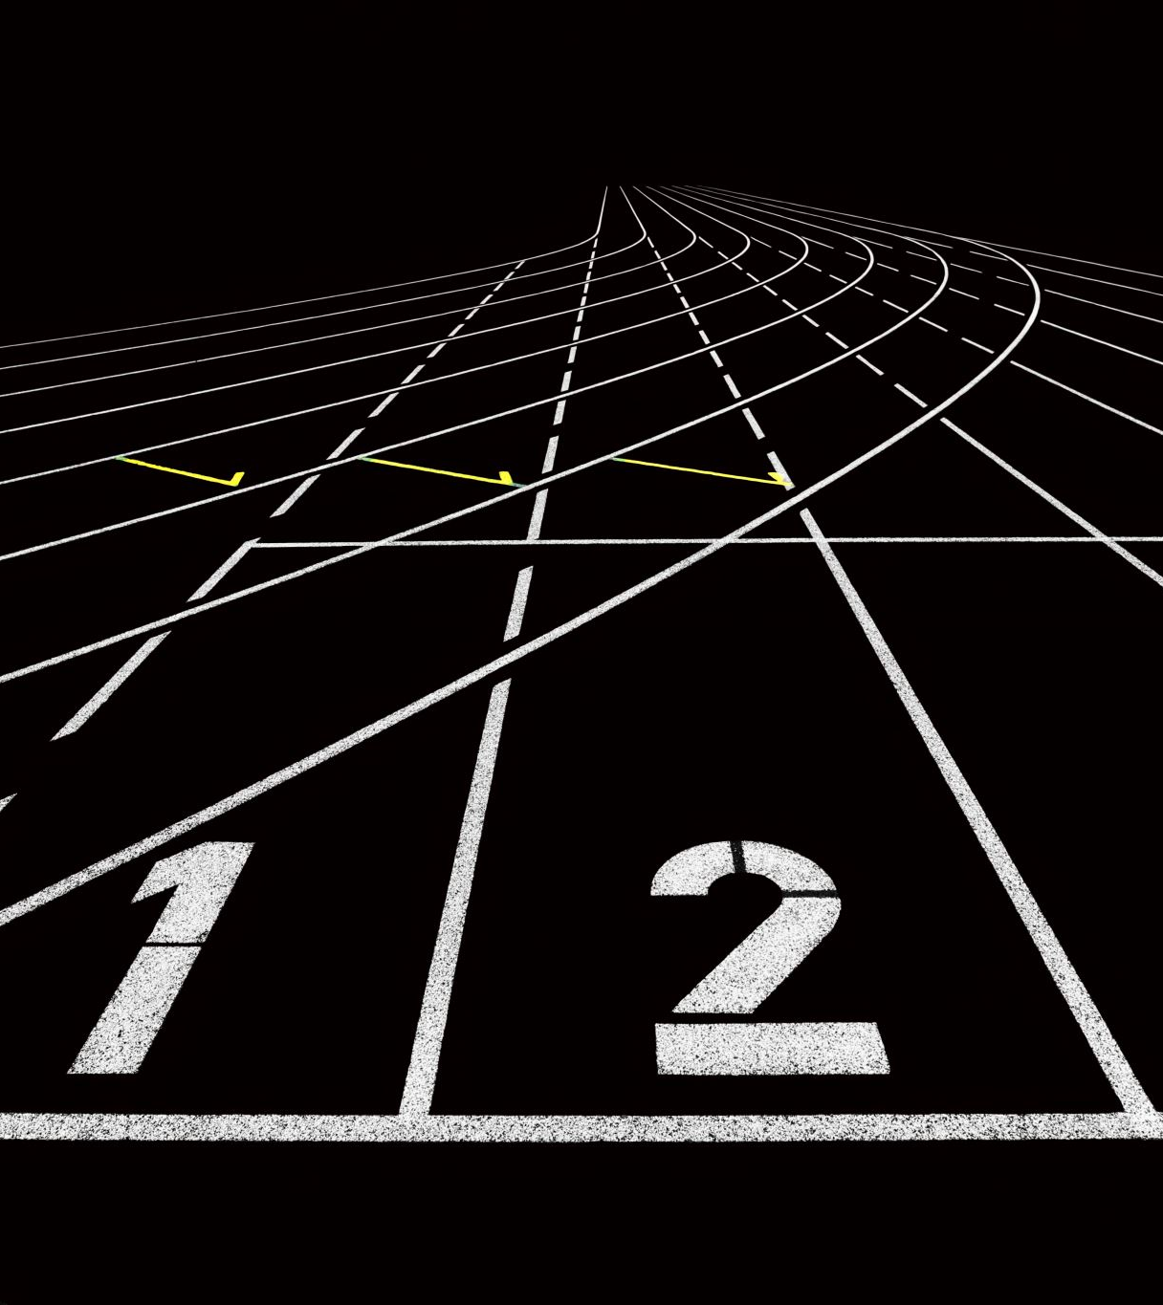
Approach:
Data Collection: https://data.mendeley.com/datasets/9xjx8twk8p/1
The data is organized into categories according to the comments made, enabling classification into different labels are as follows:
Sexual
Not Bully
Religious
Threat
Troll
The labels mentioned above serve as target variables for classifying the comments.

Slide 6
Hierarchy:
Dataset Acquisition and Preprocessing
Exploratory Data Analysis (EDA)
Model Development
Select and Compare the models
Evaluation
Training and Optimization

Slide 7
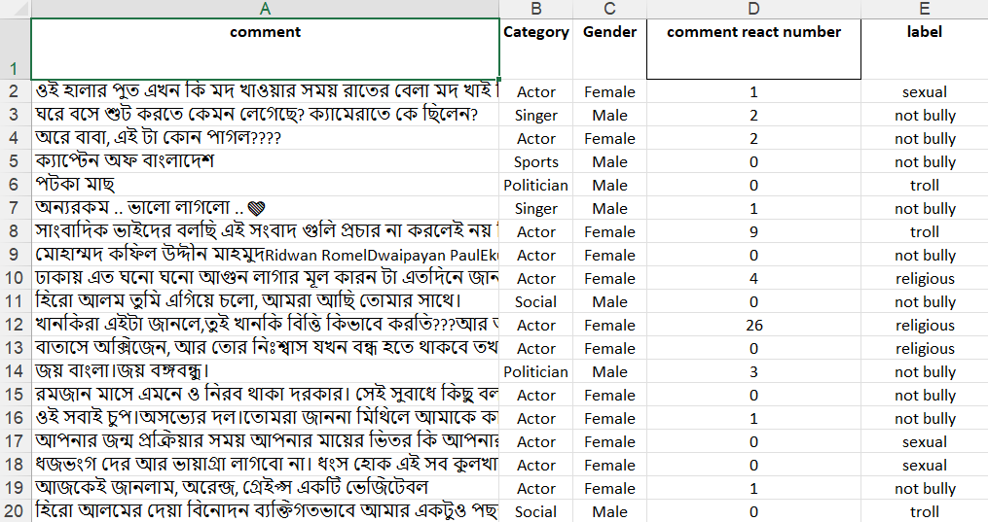
Sample Data:

Slide 8
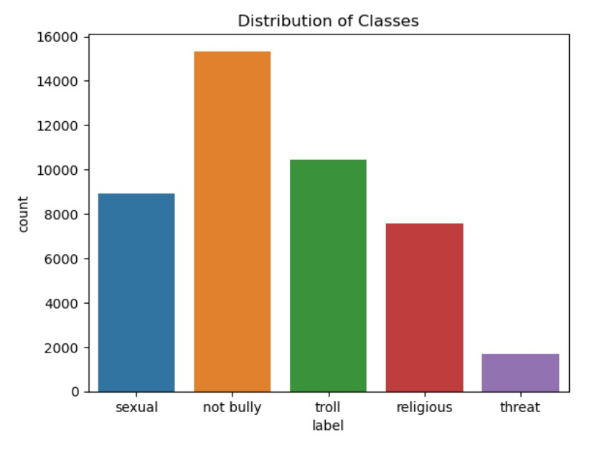

Graphical Representation of Data:

Slide 9
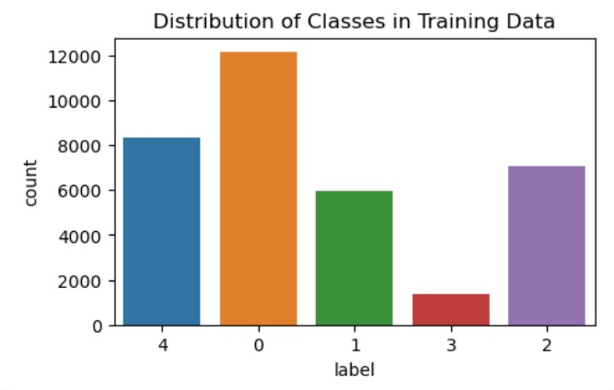
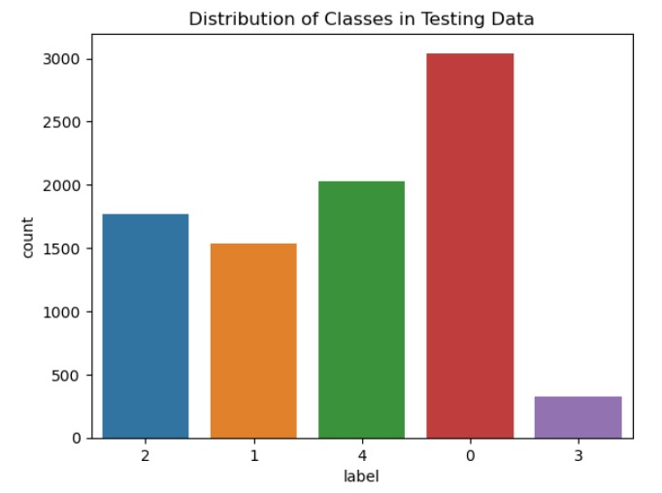

Slide 10
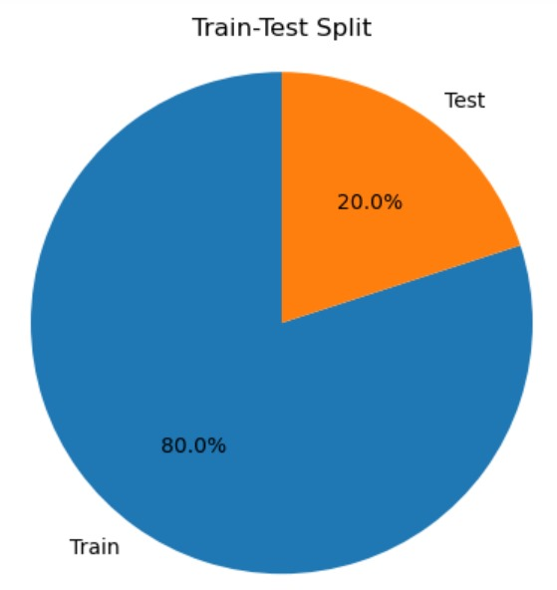
Visual Representation of Data into Training-Testing
The image shows a pie chart with two sections, labeled "Train" and "Test". The "Train" section is much larger, taking up 80% of the pie, while the "Test" section is only 20%. This is a common split for machine learning datasets, where the majority of the data is used to train the model and the remaining data is used to test the model's performance.
The test set is used to evaluate the model's performance on data that it has not seen before. This helps to ensure that the model is not simply overfitting to the training data, and that it can generalize to new data

Slide 11

Deliverables:
Bangla Text Dataset: Preprocessed and split into training, validation, and test sets.
Exploratory Data Analysis (EDA) Report: Analysis of statistical properties and visualizations of the dataset.
Trained Models: Logistic Regression, Multinomial Naive Bayes, Decision Tree Algorithms , SVM, Random Forest.
Evaluation Metrics Results: Performance evaluation metrics for each model (accuracy, precision, recall, F1-score).
Comparative Analysis Report: Analysis comparing the effectiveness of different models for Bangla text classification tasks.

Slide 12
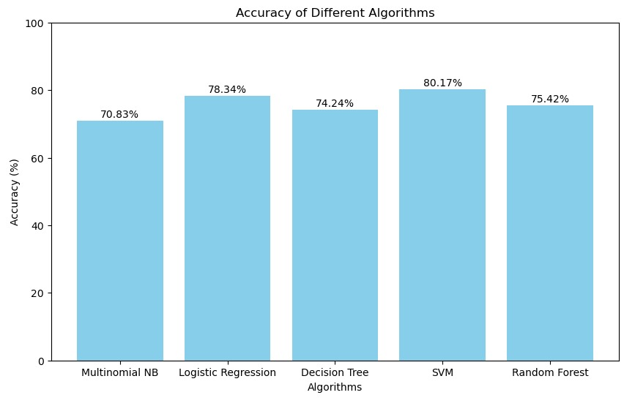
Output:

Slide 13
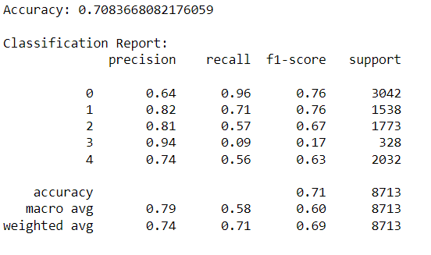
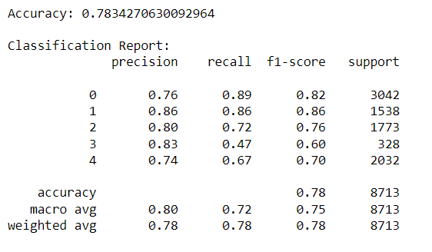
Evaluation Metrics: Multinomial NB vs Logistic Regression

Slide 14
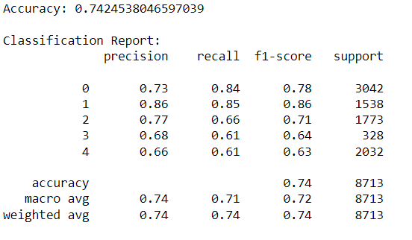
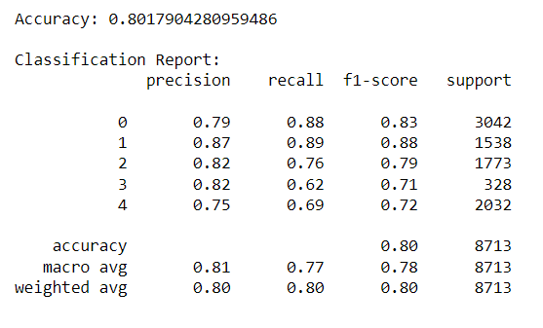
Decision Tree vs SVM

Slide 15
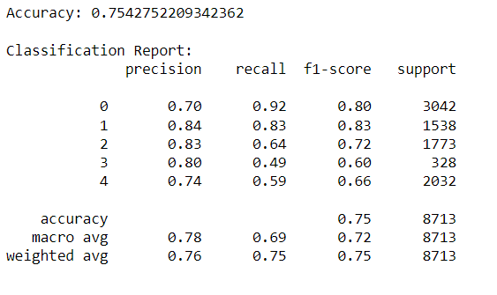
Random Forest

Slide 16
Conclusion:
The results of this experiment show that SVM is the most accurate algorithm for text classification, with an accuracy of 80.17%. This is followed by Logistic Regression at 78.34%, Random Forest at 75.42%, Decision Tree at 74.24%, and Multinomial NB at 70.83%.
These results suggest that SVM is the best algorithm to use for our text classification tasks, as it is able to learn complex relationships between the features of the data and the target variable.

Slide 17


